Slide 1


Presentation on Predictive Modelling Using Historical Sales Data to Forecast Future Product Demands
Guided By: Presented By:
Prof. Mahendra Verma Atharv Sharma (0827IT233D02)
Khushi Agrawal (0827IT221076)
Akshat Soni. (0827IT221011)
Amay Saxena. (0827IT221014)

Slide 2
Contents
Introduction
1.1 Overview
1.2 Purpose
Requirement Engineering
2.1 Requirement Collection
2.2 Functional Requirements
2.3 Non Functional Requirements
2.4 Use Case Diagram
Technical Design
3.1 Technical Architecture
3.2 Sequence Diagram
3.3 Class Diagram
3.4 DFD
User Interface Design
Data Design
5.1 Schema Design
5.2 E-R Diagram
REFERENCES

Slide 3
1. Introduction
1.1 Overview
Businesses struggle with stockouts or overstocking due to poor demand prediction.
Our system uses ML models to forecast future product demand.
Enables data-driven inventory decisions.
Improves operational efficiency and customer satisfaction.
1.2 Purpose
Predict future product demand accurately.
Reduce inventory holding and wastage.
Provide real-time inventory insights.
Optimize stock levels across supply chain locations.

Slide 4
2. Requirement Engineering 2.1 Requirement Collection
User Surveys & Interviews: Talked to local retailers, students, and faculty to understand pain points in inventory management and what features they would value in a predictive system (e.g., low-stock alerts, visual forecasts, etc.).
Studying Similar Systems: Analyzed platforms like Zoho Inventory, TradeGecko, and Odoo to identify commonly used forecasting features, gaps in UI, and limitations in real-time inventory tracking.
Continuous Feedback Loop: Created wireframes and UI mockups of the inventory dashboard; shared with early users (store operators, faculty mentors) for iterative feedback on features like data upload, report generation, and forecasting display.
Consultation with Tech Experts: Discussed technology stack (Flask backend, ML models, Firebase/PostgreSQL for inventory data) with experienced developers to ensure the system could handle real-time predictions and future scaling.

Slide 5
2.2 Function Requirements
Data Upload Module: Users should be able to upload historical sales data in CSV or Excel formats, with preprocessing handled automatically (missing value handling, normalization, etc.).
Demand Forecasting Engine: Implements time series and machine learning models (ARIMA, XGBoost, LSTM) to predict product demand based on historical trends and seasonality.
Inventory Optimization Dashboard: Visualizes current stock, predicted demand, reorder suggestions, and alerts for overstock/understock conditions.
Report Generation & Export: Generates demand forecasts and inventory suggestions as downloadable PDF/Excel reports for weekly/monthly planning.

Slide 6
2.2 Non Functional Requirements
Performance and Scalability:
The system must handle large datasets of historical sales data and generate forecasts in real-time. Ensure that the forecasting models can scale as the volume of data increases, maintaining high accuracy and low latency.
Availability and Reliability:
The system should be available 24/7 with minimal downtime to support ongoing inventory monitoring and demand forecasting. Implement automatic failover and recovery mechanisms to ensure continuous operation in case of system failure.
Security and Data Integrity:
The platform must ensure secure access to sensitive sales and inventory data through encryption, user authentication, and role-based access control. Data integrity should be maintained with frequent backups and validation checks on the accuracy of the forecasted data.

Slide 7
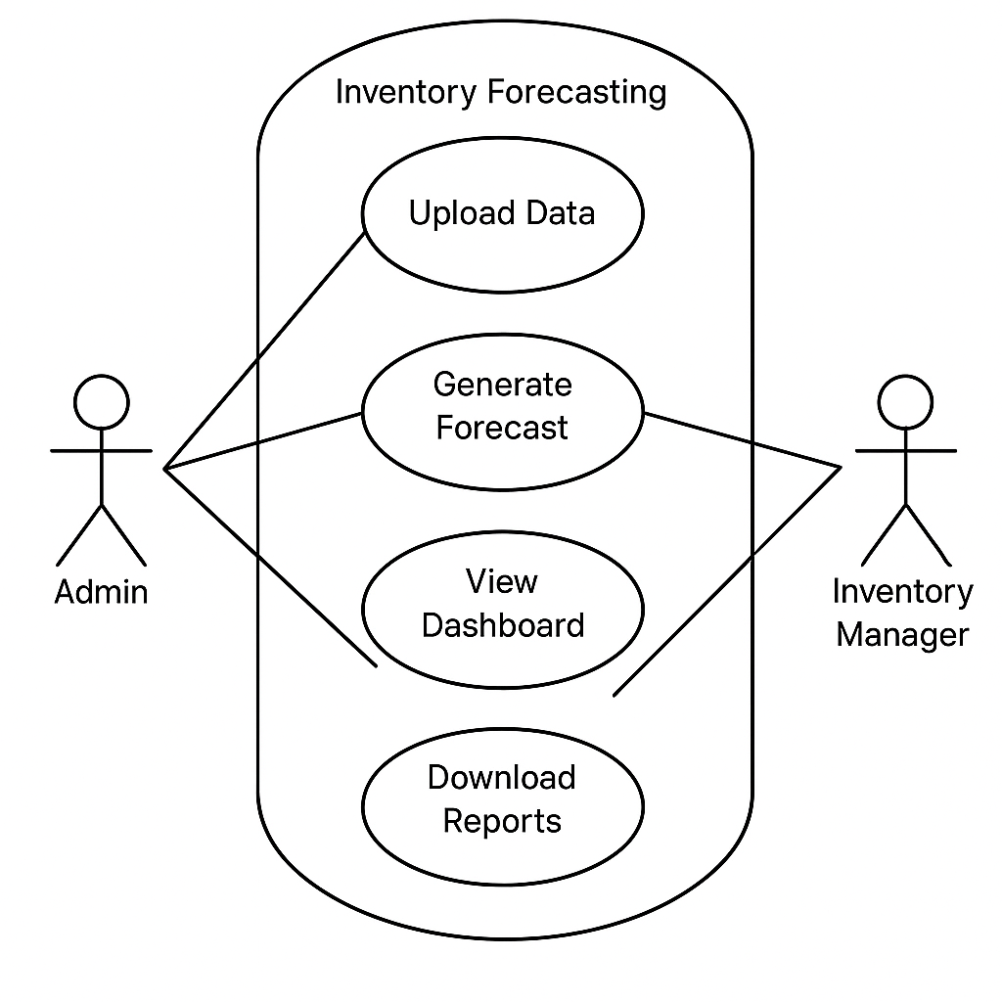
2.3 Use Case Diagram
System Use Case Diagram

Slide 8
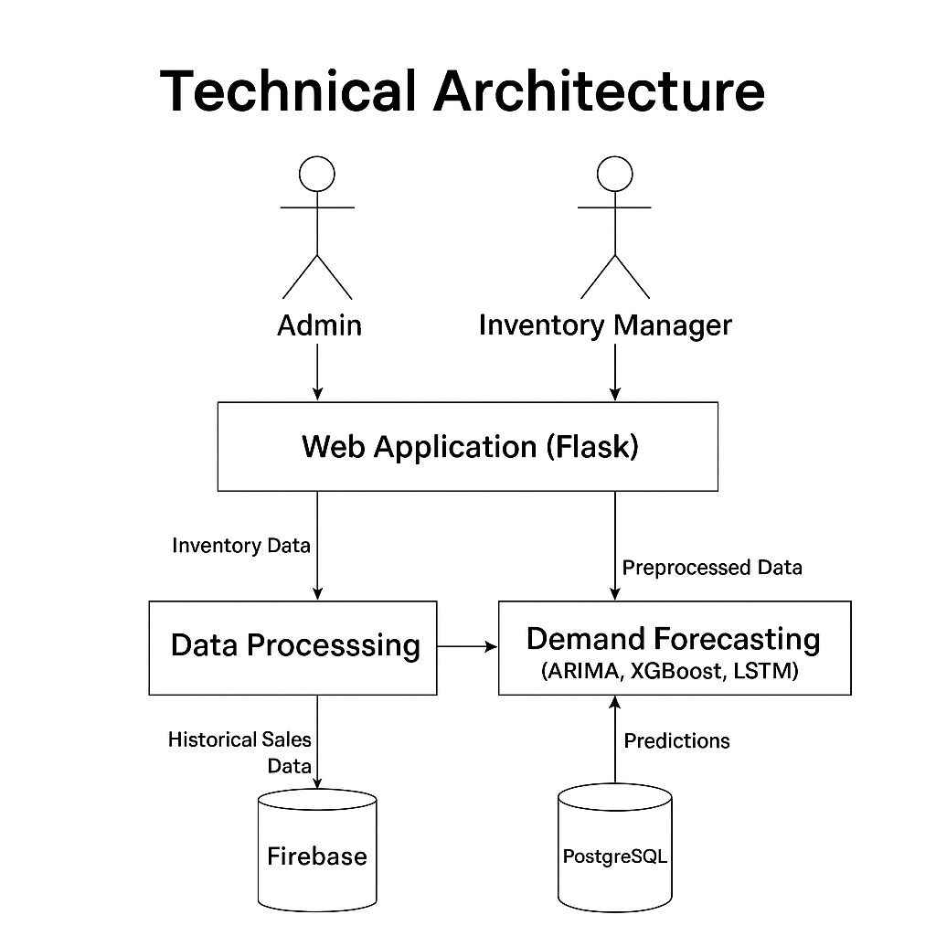
3. Technical Design 3.1 Technical Architecture
System Architecture Diagram

Slide 9
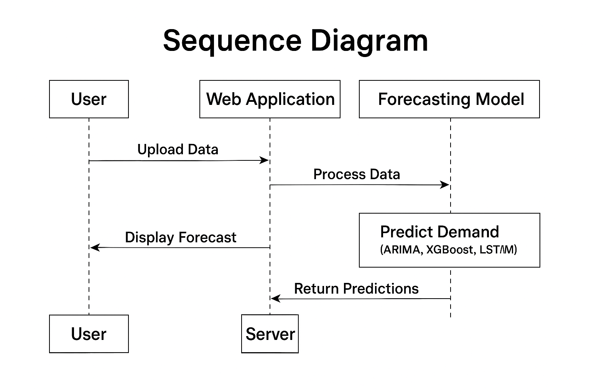
3.2 Sequence Diagram
System Sequence Diagram

Slide 10
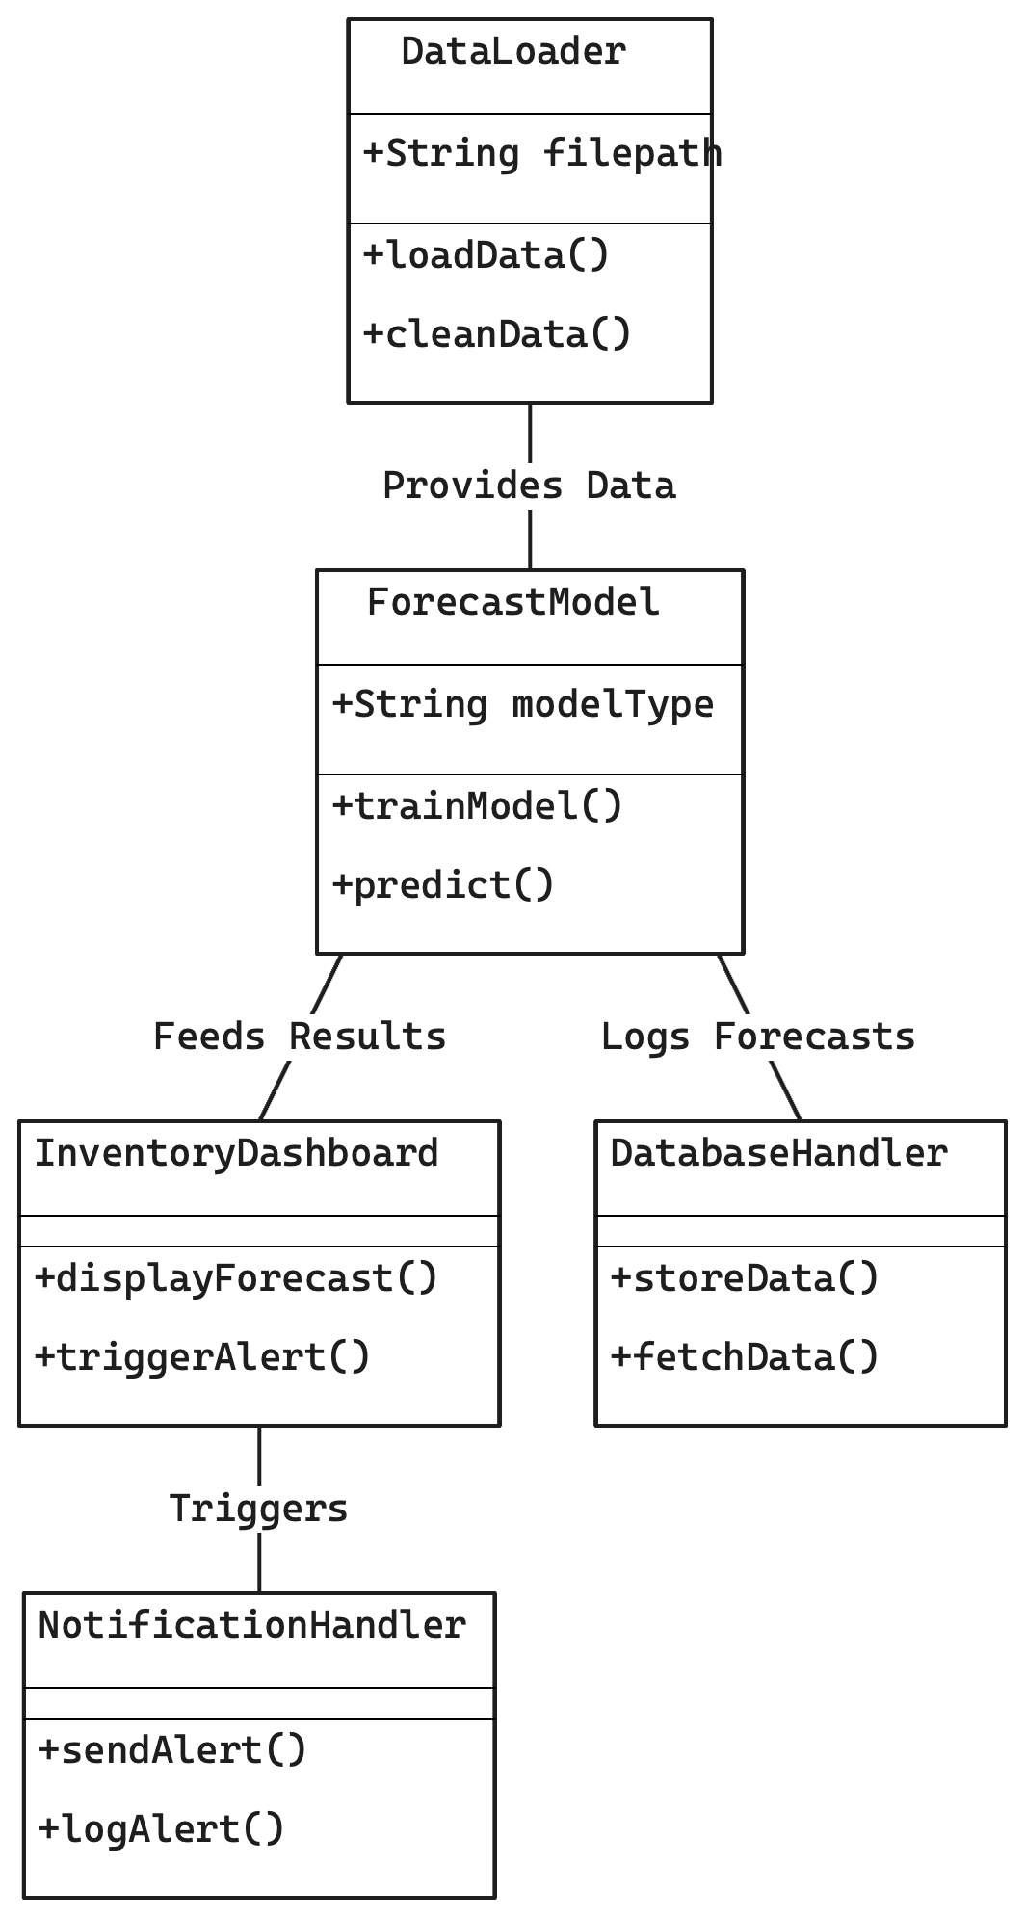
3.3 Class Diagram
System Class Diagram

Slide 11
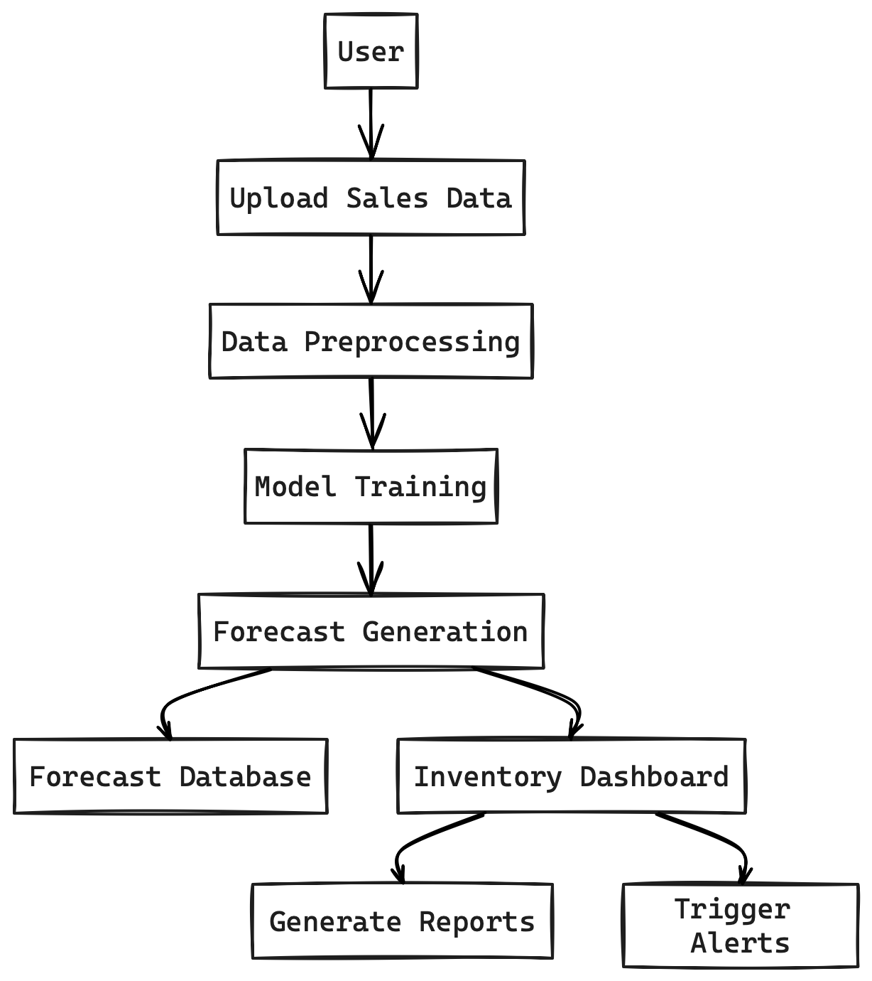
3.4 DFD
DFD Diagram

Slide 12
4. User Inface Design
(Note: Need to show the Working UI during the presentation and Attach Screen Shots of working UI here)

Slide 13
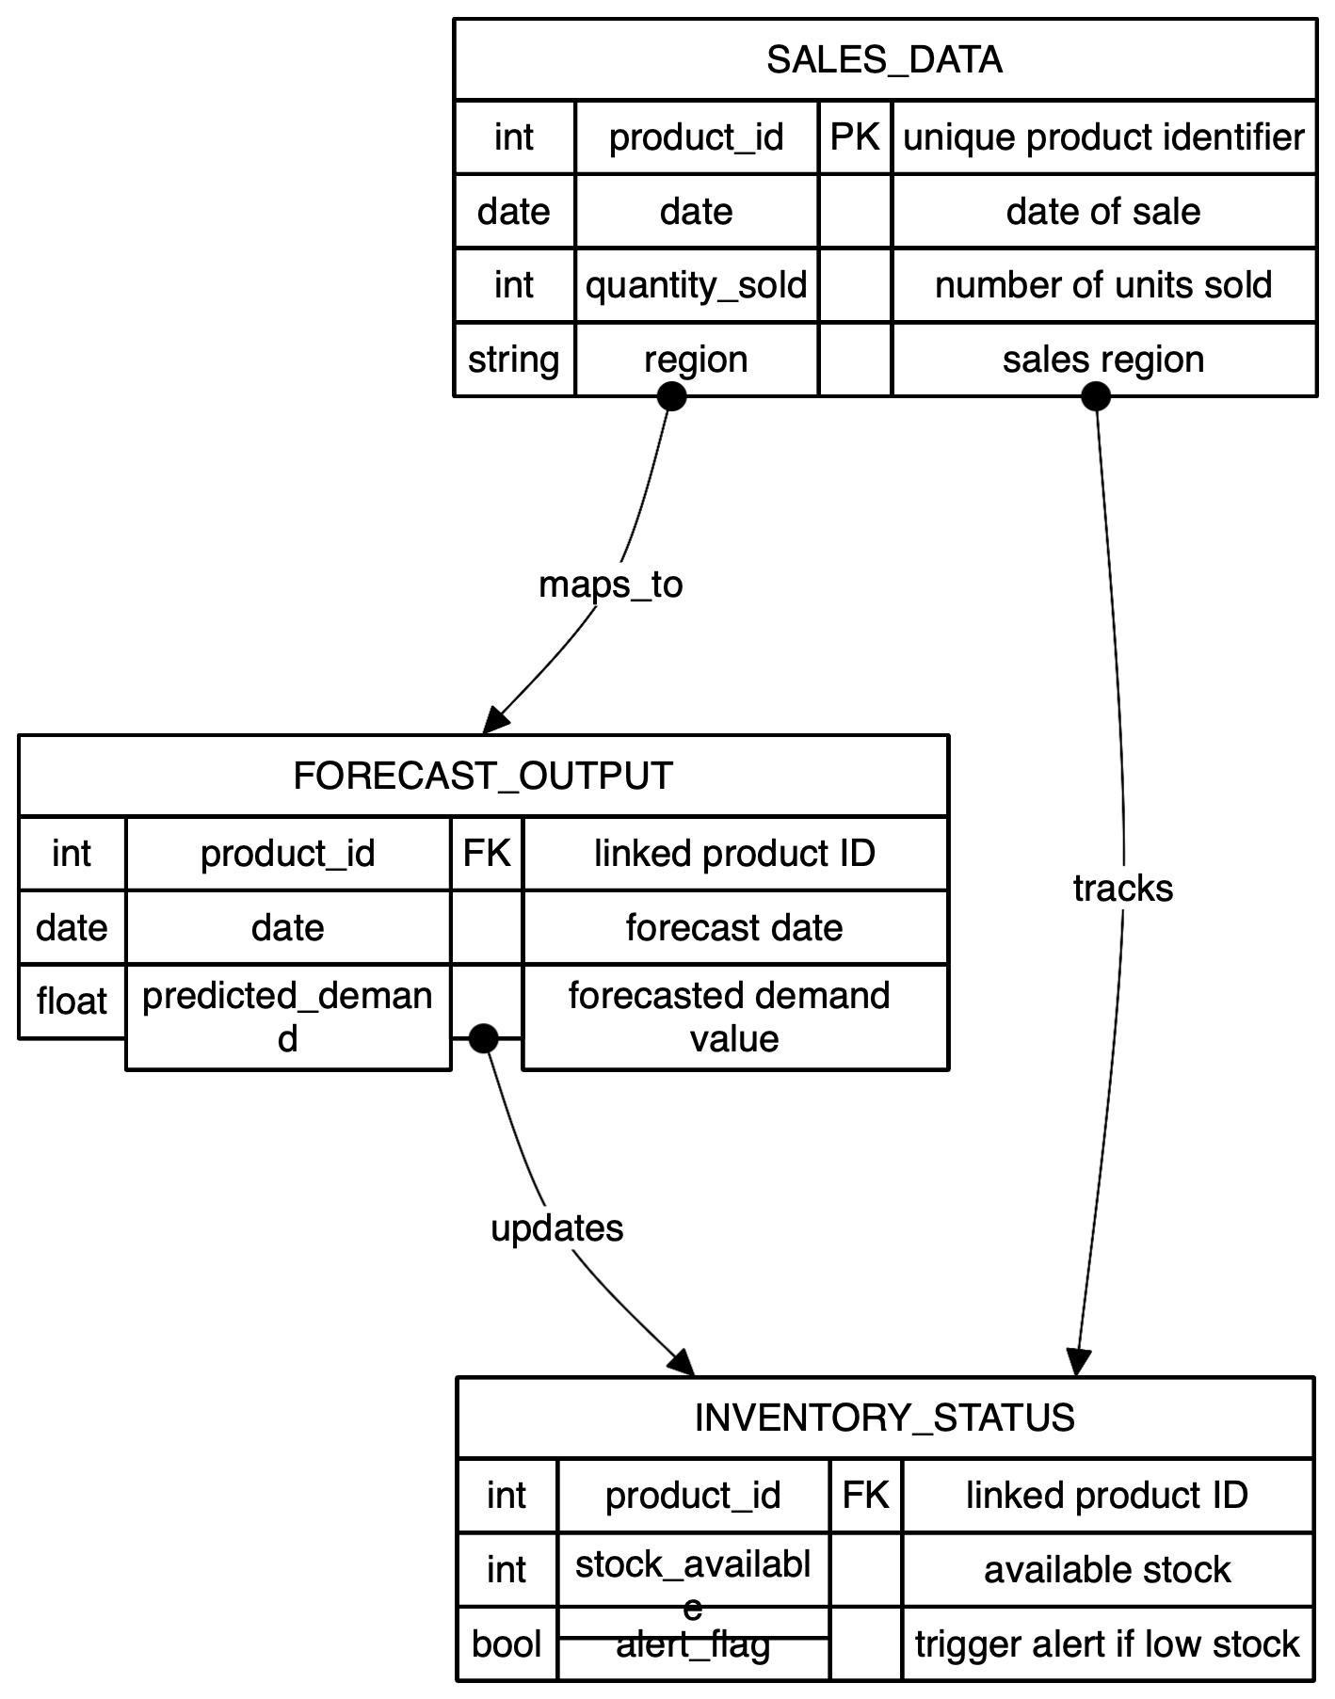
4. Data Design 4.1 Schema Definition
Complete Database Design.

Slide 14
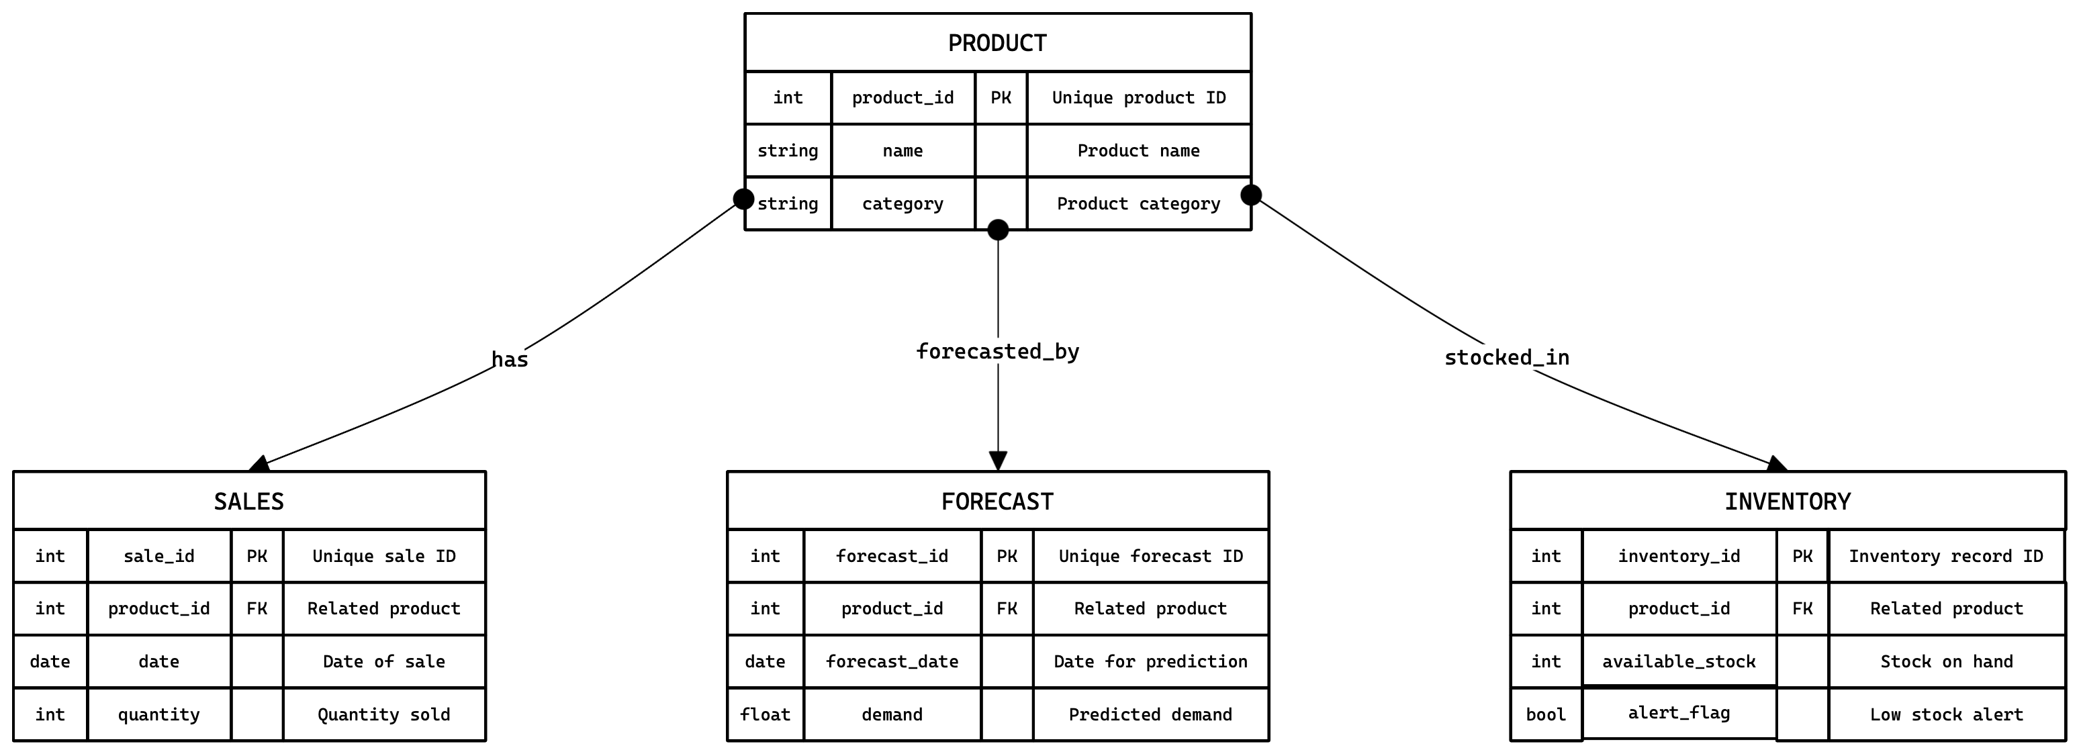
4.2 E-R Diagram
System E-R Diagram

Slide 15
GitHub Link
https://github.com/Atharv9406/SMART-INVENTORY-MANAGEMENT

Slide 16
REFERENCES
https://www.researchgate.net/publication/383560175_AI-driven_demand_forecasting_Enhancing_inventory_management_and_customer_satisfaction
https://disk.com/resources/inventory-forecasting-methods-to-reduce-stockouts-overstock/#:~:text=Seasonality%20Analysis,-Retailers%20often%20face&text=This%20method%20relies%20on%20historical,by%20managing%20their%20inventory%20carefully
https://www.pecan.ai/blog/predictive-inventory-management/
https://thousense.ai/blog/accurate-demand-forecasting-for-effective-inventory-management/
https://codup.co/blog/how-to-avoid-overstocking-and-stockouts-in-retail-best-practices-for-inventory-planning/
https://www.netstock.com/blog/demand-forecasting-for-supply-chains-how-to-predict-plan/
https://ijrpr.com/uploads/V5ISSUE10/IJRPR34021.pdf

Slide 17
Thank You
Queries ?

